Slide 1
Chapter 11:
Representation & Description
Digital Image Processing

Slide 2
Overview
Representation used to make the date useful to a computer (further process : description)
representing region in 2 ways
  in terms of its external characteristics (its boundary)  focus on shape characteristics
  in terms of its internal characteristics (its region)  focus on regional properties, e.g., color, texture
sometimes, we may need to use both ways

Slide 3
Overview
Description describes the region based on the chosen representation
ex.
  representation  boundary
  description  length of the boundary, orientation of the straight line joining its extreme points, and the number of concavities in the boundary.

Slide 4
Sensitivity
feature selected as descriptors should be as insensitive as possible to variations in
  size
  translation
  rotation
following descriptors satisfy one or more of these properties.

Slide 5
Representation
Segmentation techniques yield raw data in the form of pixels along a boundary or pixels contained in a region
these data sometimes are used directly to obtain descriptors
standard uses techniques to compute more useful data (descriptors) from the raw data in order to decrease the size of data.

Slide 6
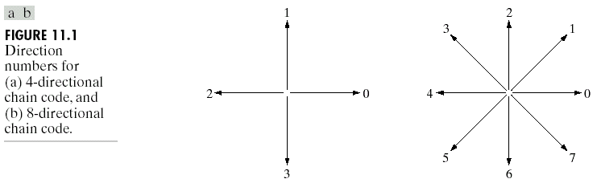
Chain codes
based on 4 or 8 connectivity

Slide 7
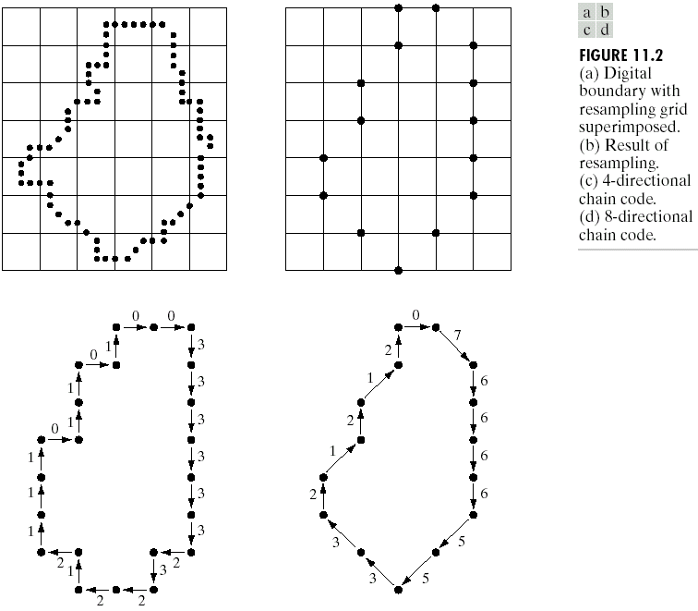

Slide 8
Chain codes
unacceptable because
  the resulting chain of codes tends to be quite long
  any small disturbances along the boundary due to noise or imperfect segmentation cause changes in the code that may not be related to the shape of the boundary

Slide 9
Chain codes
circumvent the problems by
  resample the boundary by selecting a larger grid spacing
  however, different grid can generate different chain codes
starting point is arbitrary
need to normalize the generated code so that codes with different starting point will become the same.

Slide 10
Normalized chain codes
treat the chain code as a circular sequence of direction numbers and redefine the starting point so that the resulting sequence of numbers forms an integer of minimum magnitude  “shape numbers”
or use rotation of the first different chain code instead
difference = the number of direction changes in a counterclockwise direction
ex.
  code 10103322
  different is 3133030
  circular chain code: 33133030
  rotation of circular chain code : 03033133

Slide 11
Normalized chain codes
are exact only if the boundaries are invariant to rotation and scale change.
but these are seldom cases.

Slide 12
Polygonal Approximations
boundary can be approximated with arbitrary accuracy by a polygon
try to capture the “essence” of the boundary shape with the fewest possible polygonal segments.
not trivial and time consuming

Slide 13
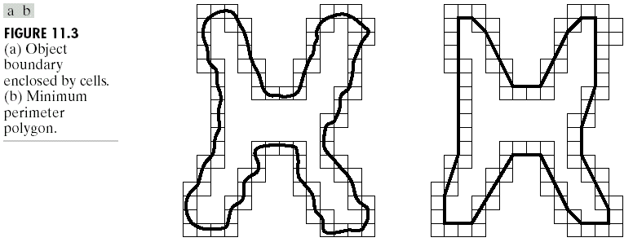

Minimum perimeter polygons
if each cell encompass only one point on the boundary
error is at most be
d is the minimum possible distance between different pixels

Slide 14
Merging techniques
based on average error or other criteria
merge points along the boundary until the least square error line fit of the points merged so far exceeds a preset threshold

Slide 15
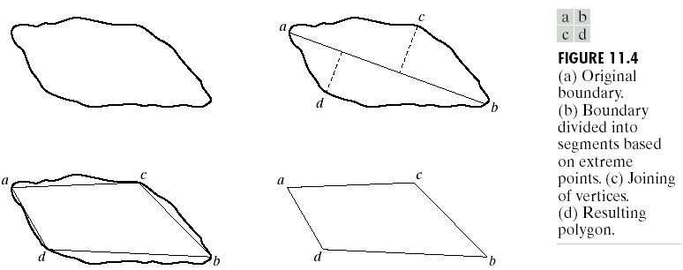
Splitting techniques
find the major axis
find minor axes which perpendicular to major axis and has distance greater than a threshold
repeat until we can’t split anymore

Slide 16
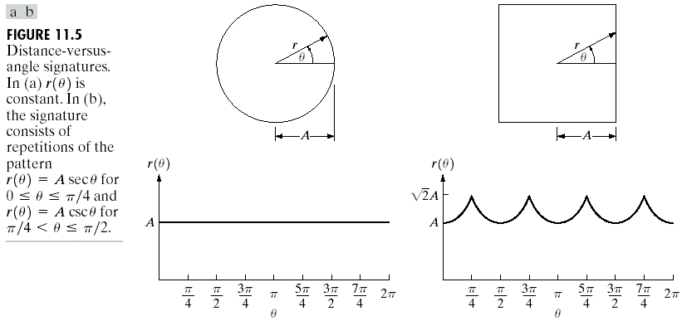
Signatures
map 2D function to 1D function

Slide 17
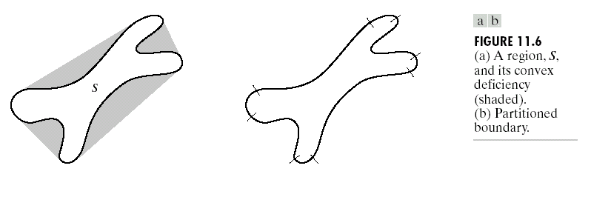
Boundary Segments
convex hull H of an arbitrary set S is the smallest convex set containing S
the set different H-S is called convex deficiency D of the set S

Slide 18
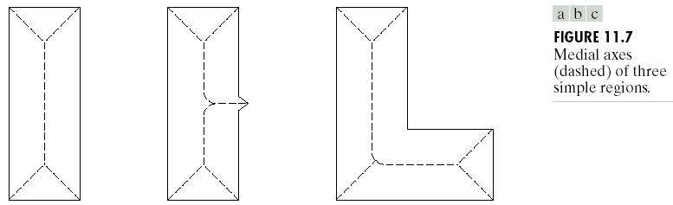
Skeletons
medial axis (skeleton)

Slide 19
MAT
MAT of region R with border B is as follows.
  for each point p in R, we find its closet neighbor in B.
  if p has more than one such neighbor, it is said to belong to the medial axis of R
closest depends on the definition of a distance

Slide 20
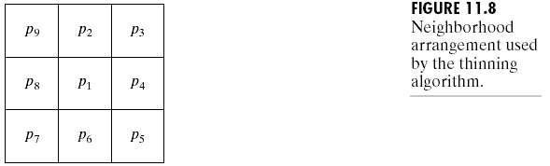
Thinning
iterative deleting edge points of a region with constraints
does not remove end points
does not break connectivity
does not cause excessive erosion of the region

Slide 21
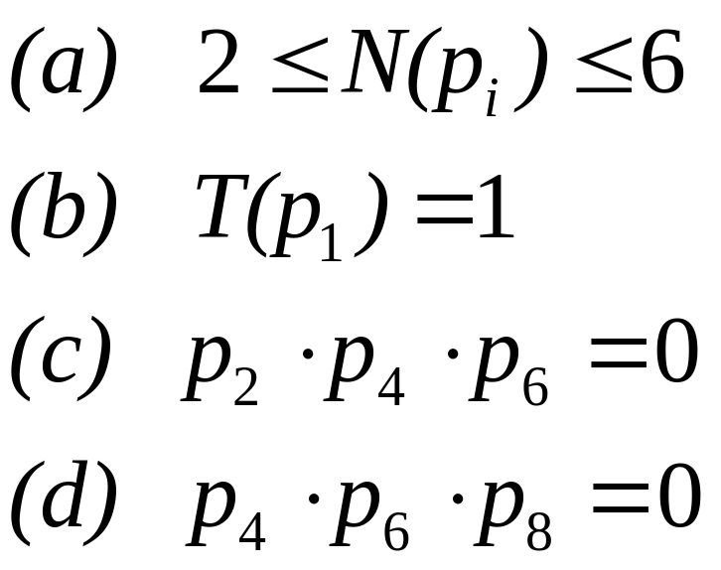
assume region points have value 1 and background points have value 0
contour point is any pixel with value 1 and having at least one 8-neighbor valued 0
step 1: flag a contour point p₁ for deletion if the following conditions are satisfied
N(p_{i}) is the number of nonzero neighbors of p_{i}

Slide 22
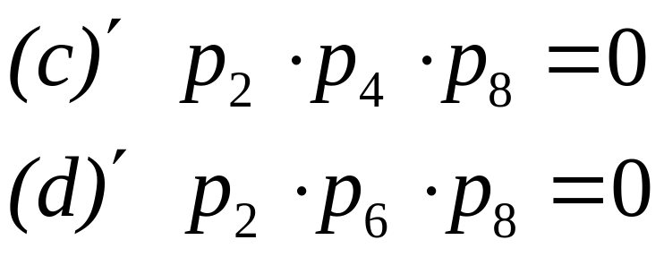
after step 1 has marked every boundary points satisfy all 4 conditions, delete those pixels.
step 2: remain condition (a) and (b) but change conditions (c) and (d) to follows
flagged the remain border points for deletion.
then delete the marked points
repeat step 1) and 2) until no more points to delete

Slide 23
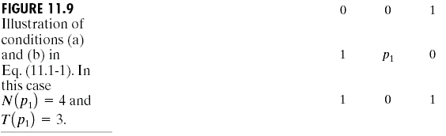
Example

Slide 24
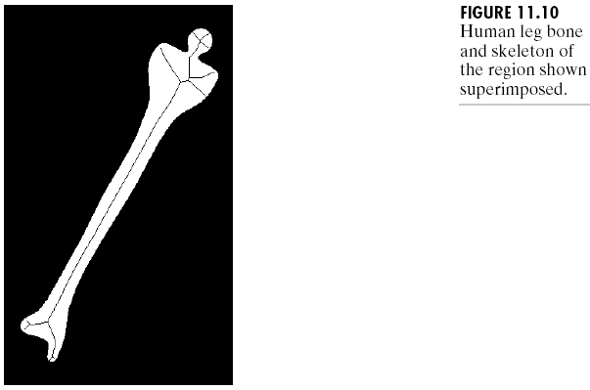
Example

Slide 25
Boundary Descriptors
length of a boundary
diameters
eccentricity
curvature
shape numbers
Fourier descriptors

Slide 26
Length of a boundary
the number of pixels along a boundary
give a rough approximation of its length

Slide 27

Diameters
D is a distance measure
p_{i} and p_{j} are points on the boundary B

Slide 28
Eccentricity
ratio of the major to the minor axis
major axis = the line connecting the two extreme points that comprise the diameter
minor axis = the line perpendicular to the major axis

Slide 29
Curvature
the rate of change of slope
difficult to do as digital boundaries tend to be locally “ragged”
using the difference between the slopes of adjacent boundary segments (which represented as straight lines)
use Merging and Splitting to create adjacent boundary segments
concave, convex and coner

Slide 30
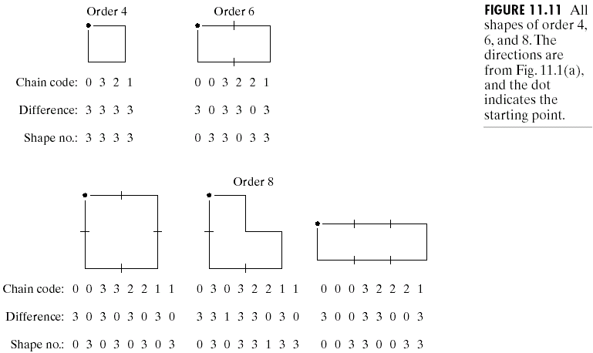
Shape numbers
4-directional code

Slide 31
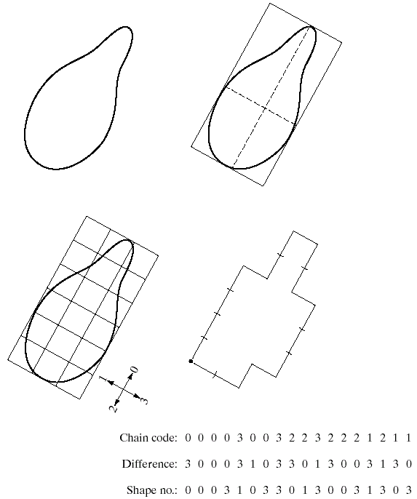
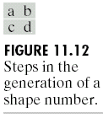

Slide 32
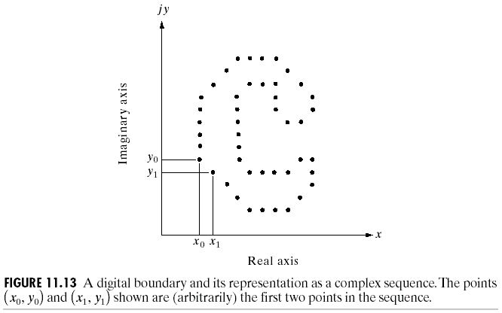
Fourier Descriptors
boundary = (x₀,y₀), … , (x_{K-1},y_{k-1})

Slide 33
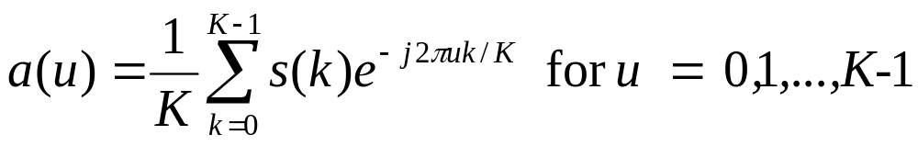
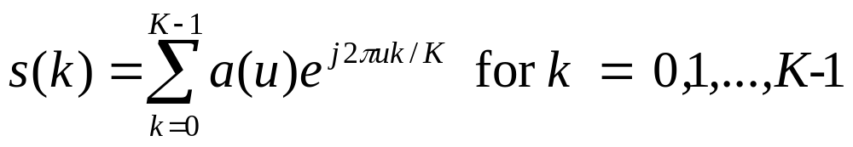
Fourier Descriptors
Fourier transformation
(DFT)
a(u) : Fourier coefficients (Fourier Descriptors)
Inverse Fourier transformation

Slide 34
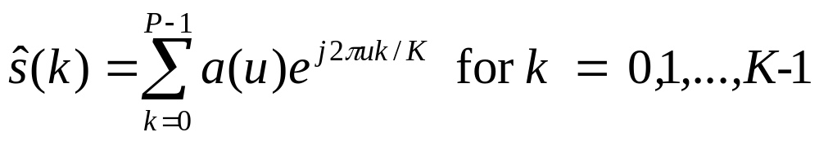
P Coefficient of Fourier Descriptors
approximation to s(k)
descriptors  P number of coefficients

Slide 35
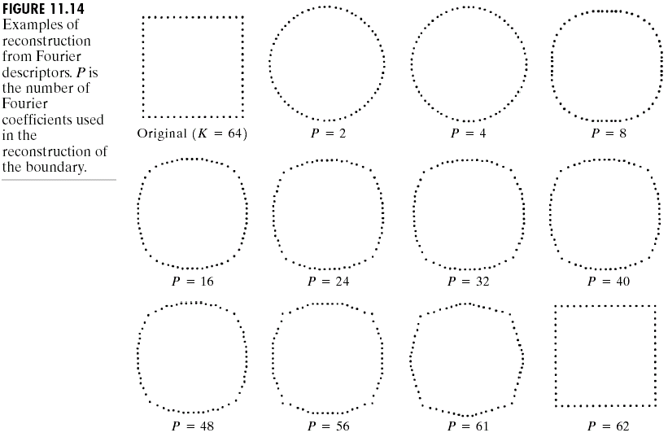

Slide 36
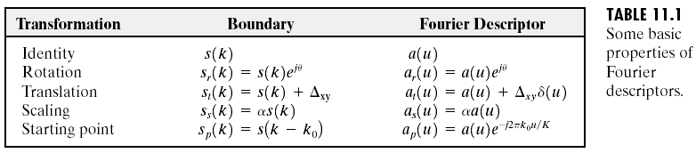
Invariant

Slide 37
Regional Descriptors
area
perimeter
compactness
topological descriptors
texture

Slide 38
Simple descriptors
area = the number of pixels in the region
perimeter = length of its boundary
Compactness = (perimeter)²/area

Slide 39
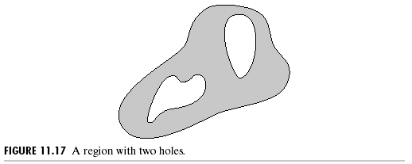
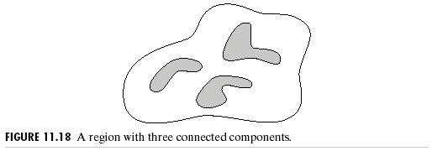
Topological descriptors
E = C - H
E = Euler number
C = number of connected region
H = number of holes

Slide 40
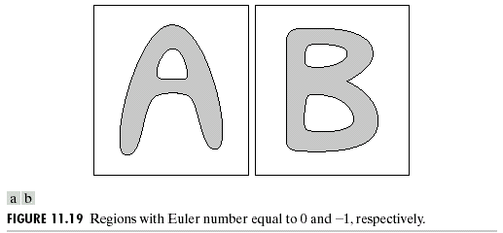
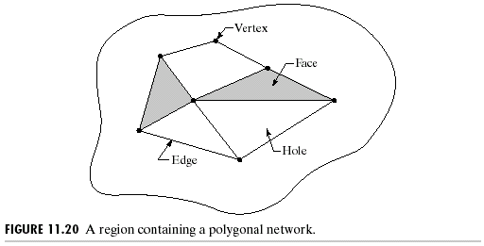
Straight-line segments (polygon networks)
V – Q + F = C – H = E
V = number of vertices
Q = number of edges
F = number of faces
7-11+2 = 1-3 = -2

